Slide 1
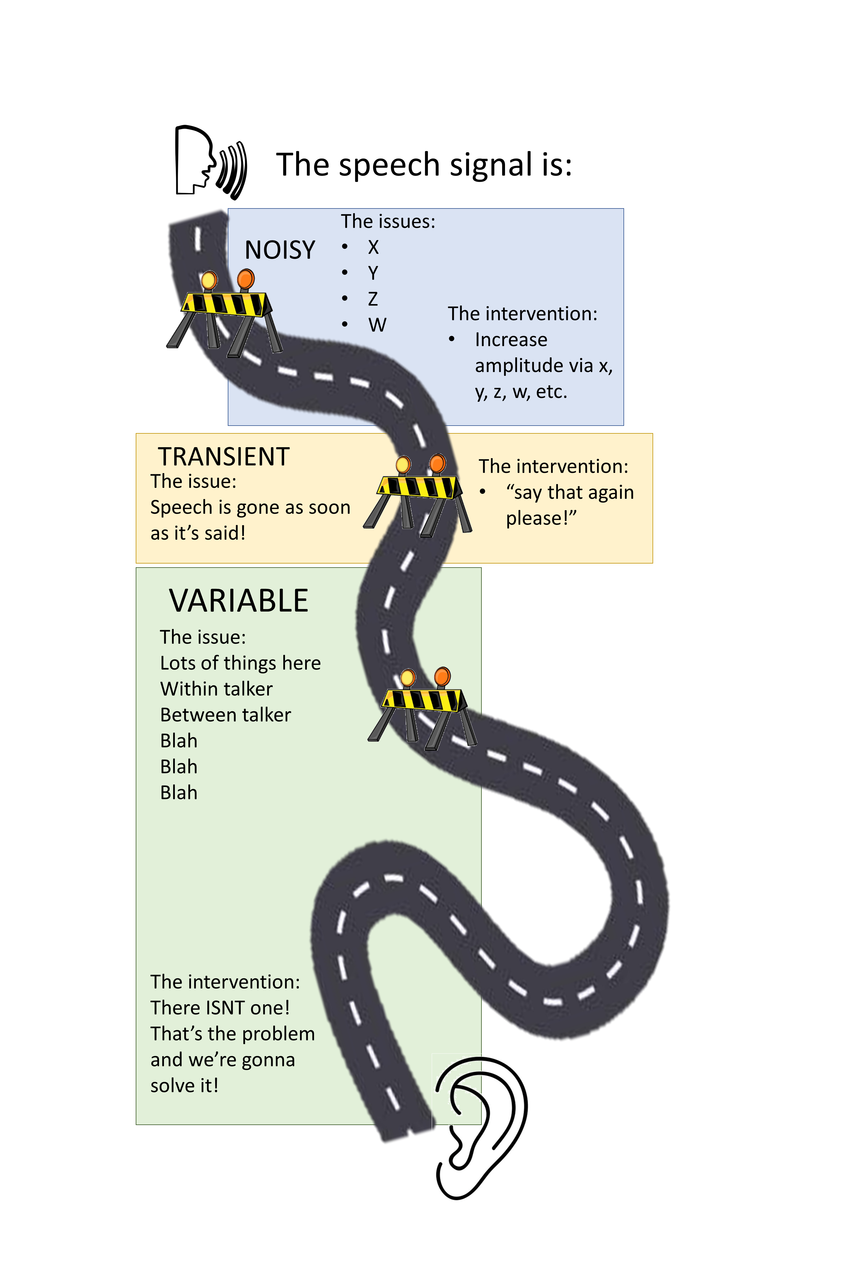


The speech signal is:
The issues:
X
Y
Z
W
NOISY
The intervention:
Increase amplitude via x, y, z, w, etc.
TRANSIENT
The intervention:
“say that again please!”
The issue:
Speech is gone as soon as it’s said!
VARIABLE
The issue:
Lots of things here
Within talker
Between talker
Blah
Blah
Blah
The intervention:
There ISNT one!
That’s the problem and we’re gonna solve it!

Slide 2
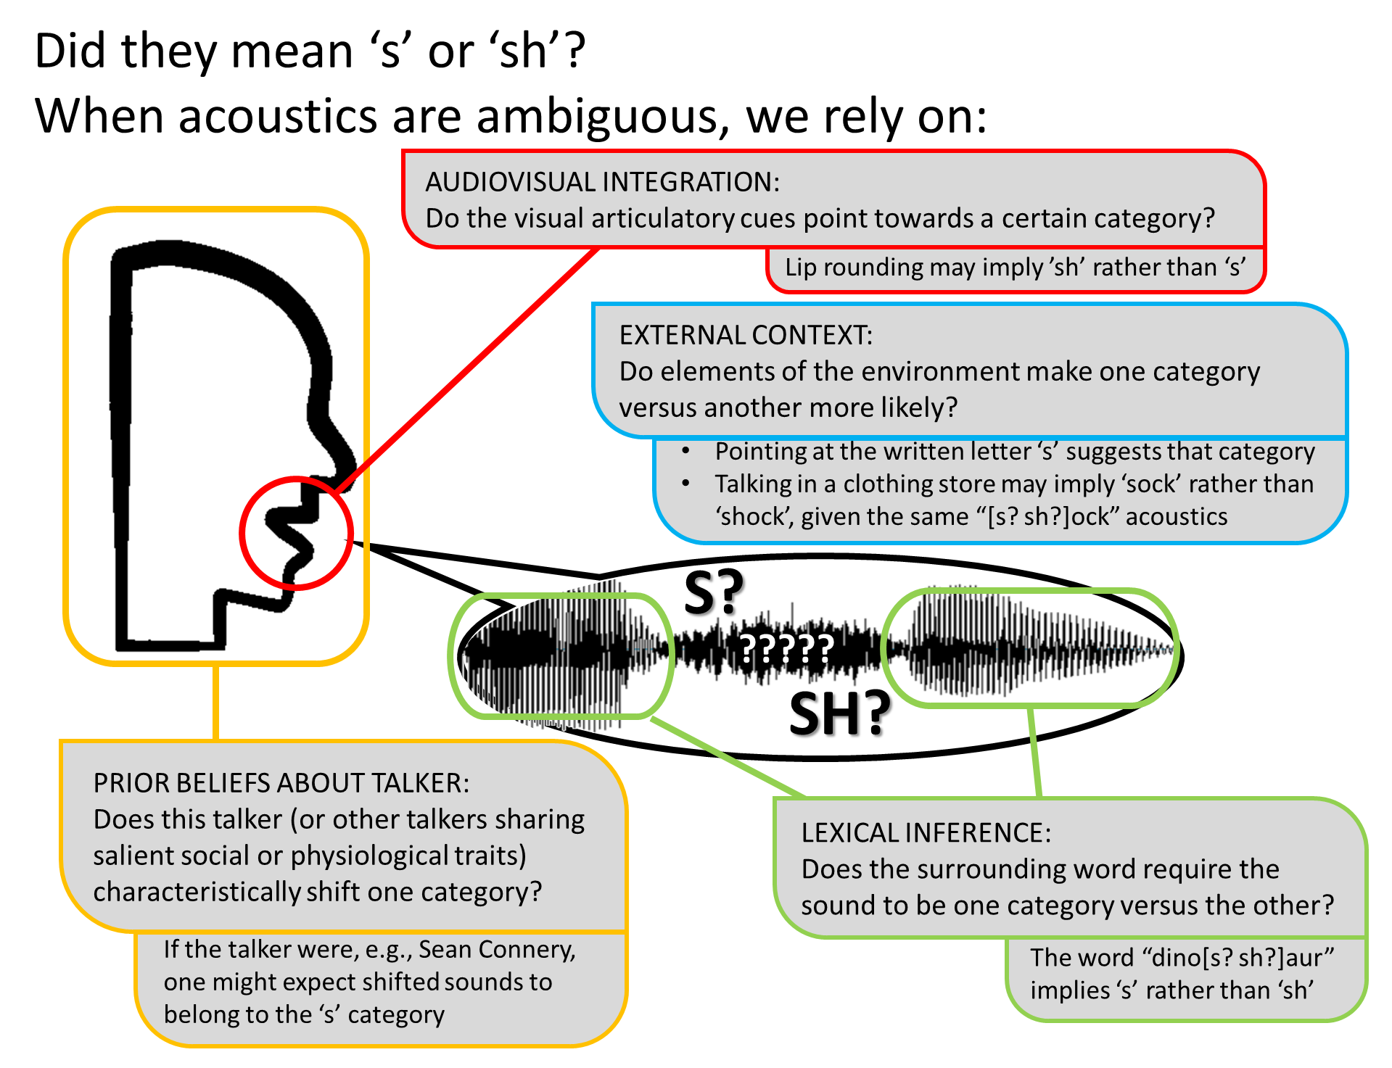

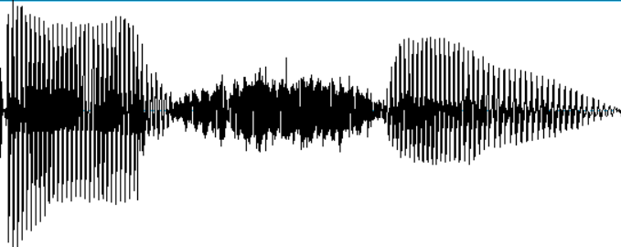
Did they mean ‘s’ or ‘sh’?
When acoustics are ambiguous, we rely on:
AUDIOVISUAL INTEGRATION:
Do the visual articulatory cues point towards a certain category?
Lip rounding may imply ’sh’ rather than ‘s’
EXTERNAL CONTEXT:
Do elements of the environment make one category versus another more likely?
Pointing at the written letter ‘s’ suggests that category
Talking in a clothing store may imply ‘sock’ rather than ‘shock’, given the same “[s? sh?]ock” acoustics
S?
?????
SH?
PRIOR BELIEFS ABOUT TALKER:
Does this talker (or other talkers sharing salient social or physiological traits) characteristically shift one category?
LEXICAL INFERENCE:
Does the surrounding word require the sound to be one category versus the other?
If the talker were, e.g., Sean Connery, one might expect shifted sounds to belong to the ‘s’ category
The word “dino[s? sh?]aur” implies ‘s’ rather than ‘sh’

